Slide 1
CSC410 - Professional Practices in IT
Instructor Name : Sidra Nasir

Slide 2
Today Topics
Censorship
Freedom of Expression
Children and Inappropriate Content
Breaking Trust

Slide 3
Censorship

Slide 4
Censorship
Censorship is the attempt to suppress or regulate public access to material considered offensive or harmful.
Historically, most censorship has been exercised by governments and religious institutions.
For example, Roman censors banished the poets Ovid and Juvenal for their writings. During the Middle Ages the Inquisition suppressed the publication of many books, including the work of Galileo Galilei.

Slide 5
Forms of Direct Censorship
Government monopolization
Prepublication review
Licensing and registration

Slide 6
Self-censorship
Most common form of censorship
Group decides for itself not to publish
Reasons
– Avoid subsequent persecution
– Maintain good relations with government officials (sources of information)
Ratings systems created to advise potential audience
– Movies, TVs, CDs, video games
– Not the Web

Slide 7
Challenges Posed by the Internet
Many-to-many communications
Dynamic connections
Huge numbers of Web sites
Extends beyond national borders, laws
Hard to distinguish between minors and
Adults

Slide 8
Governmental Filtering and Surveillance
Cuba, North Korea: Internet virtually inaccessible
Saudi Arabia: centralized control center
People’s Republic of China:
– Blocks Internet access at times of social unrest
– Has “one of most sophisticated filtering systems in the world”
Germany: Forbids access to neo-Nazi sites
United States: Have been repeated efforts to limit access of minors to pornography

Slide 9
Ethical Perspectives on Censorship
Kant opposed censorship
– Enlightenment thinker
– “Have courage to use your own reason”
Mill opposed censorship
– No one is infallible
– Any opinion may contain a kernel of truth
– Truth revealed in class of ideas
– Ideas resulting from discourse are more influential

Slide 10
Mill’s Principle of Harm
“The only ground on which intervention is justified is to prevent harm to others; the individual’s own good is not a sufficient condition.”

Slide 11
Freedom of Expression

Slide 12
Freedom of Expression: History
De Scandalis Magnatum (England, 1275)
Court of Star Chamber
18th century
– No prior restraints on publication
– People could be punished for sedition or libel
American states adopted bills of rights including freedom of expression
Freedom of expression in 1st amendment to U.S. Constitution

Slide 13
1st Amendment to U.S. Constitution
Congress shall make no law respecting an establishment of religion, or prohibiting the free exercise thereof; or abridging the freedom of speech, or of the press; or the right of the people peaceably to assemble, and to petition the government for a redress of grievances.

Slide 14
Freedom of Expression Not an Absolute Right
1st Amendment covers political and nonpolitical speech
Right to freedom of expression must be balanced against the public good
Various restrictions on freedom of expression exist

Slide 15
FCC v. Pacifica Foundation et al.
George Carlin records “Filthy Words”
WBAI in New York airs “Filthy Words” (1973)
FCC issues declaratory order to Pacifica
Pacifica sues
U.S. Supreme Court ruled FCC did not violate 1st
Amendment (5-4 decision)
– Broadcast media “uniquely pervasive”
– Broadcasting uniquely accessible to children

Slide 16
Case Study
Kate is a journalism major who maintains a popular blog focusing on campus life. Kate attends a private birthday party in someone’s apartment for her friend Jerry, a college student active in the Whig Party on campus. Someone gives Jerry a Tory Party T-shirt as a gag gift, and Jerry puts it on. Kate uses her cell phone to get a picture of Jerry wearing the T-shirt when he is looking the other way. Jerry gives Kate a ride home after the party, but she does not tell him about the photo. When she is back in her apartment, she posts the photo on her blog. In the blog she identifies Jerry and explains the context in which the photo was taken. The story is read by many people both on and off campus.

Slide 17
Cont..
The next day Jerry confronts Kate, yells at her for posting the photo, and demands that she remove it from her Web site. Kate complies with Jerry’s request by removing the photo, and the two of them remain friends. As a result of the incident, Jerry becomes more popular on campus, and the number of people who read Kate’s blog increases.
Was it wrong for Kate to post the picture of Jerry on her blog without first getting his permission?

Slide 18
Case Study: Kate’s Blog
Kate: Maintains a popular “life on campus” blog
Jerry: Another student; active in Whig Party
At private birthday party, someone gives Jerry a Tory Party T-shirt as a gag, and Jerry puts it on
Kate uses cell phone to take picture of Jerry when he isn’t looking, posts it on her blog
Story read by many people on and off campus
Jerry confronts Kate and demands she remove photo; she complies, and they remain friends
Kate’s blog and Jerry both become more popular

Slide 19
Kantian Analysis
Kate uploaded Jerry’s photo to her blog without asking his permission
She treated him as a means to her end of increasing the readership of her Web site
Her action was wrong

Slide 20
Social Contract Theory Analysis
Birthday party held in apartment of one of Jerry’s friends
Jerry had a reasonable expectation of privacy
Kate violated Jerry’s right to privacy
Kate’s action was wrong

Slide 21
Act Utilitarian Analysis
Benefits
– Popularity of Kate’s blog increased (definitely)
– Jerry become more popular on campus (definitely)
Harms
– Jerry’s anger at Kate (only temporary)
– Photo could discredit Jerry at some point in future
(unlikely)
• Benefits greater than harms, so Kate did a good thing

Slide 22
Rule Utilitarian Analysis
What if everyone were constantly taking photos of people
they encountered and posting them?
Positive consequences
– People would have more opportunities to keep up with what their friends are doing
– People might be more reluctant to engage in illegal activities
Negative consequences
– People would become more self-conscious
– Some relationships would be harmed
Negative consequences more weighty than positive consequences, so Kate’s action was bad

Slide 23
Virtue Ethics Analysis
True friends trust each other and seek each other’s good
Reciprocity and equality are fundamental elements of friendship
Lack of reciprocity: Kate took something from Jerry without giving him anything in return
Lack of equality: She put her own interest above that of Jerry
Kate’s actions did not seem to be characteristic of a good friend

Slide 24
Summary
Four out of five analyses: Wrong for Kate to post the photo without asking Jerry’s permission
Kate figured it would be better to beg for forgiveness than ask for permission, but she cut Jerry out of a decision that affected both of them, and that’s no way to treat a friend
Kate should have tried to get Jerry’s consent

Slide 25
Children and Inappropriate Content

Slide 26
Web Filters
Web filter: Software that prevents display of certain Web pages
– May be installed on an individual PC
– ISP may provide service for customers
Methodologies
– Maintain “black list” of objectionable sites
– Examine content for objectionable words / phrases

Slide 27
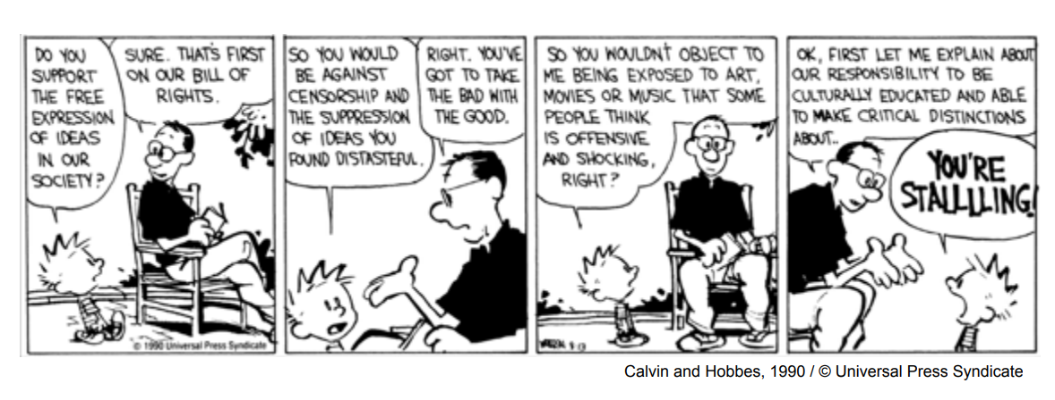

Slide 28
Child Internet Protection Act
Libraries receiving federal networking funds must filter pages containing obscenity or child pornography
U.S. Supreme Court ruled CIPA did not violate 1st Amendment guarantees (6-3 decision in June 2003)

Slide 29
Ethical Evaluations of CIPA
Kantian evaluation: CIPA is wrong
Act utilitarian evaluation: depends on how benefits and harms are weighed
Social contract theory: freedom of conscience should be given precedence

Slide 30
Sexting
Definition: sexually suggestive text messages or emails with nude or nearly nude photographs
In a 2009 survey, 9% of U.S. teenagers admitted to sending a sext, 17% admitted to receiving a sext
Case of Jesse Logan
Case of Phillip Alpert
Case of Ting-Yi Oei

Slide 31
Breaking Trust

Slide 32
Identity Theft (1/2)
Identity theft: When a person uses another person’s electronic identity
Leading form of identity theft is credit card fraud
Financial institutions contribute to problem by making it easy to open new accounts
About 8 million cases of identity theft in U.S. in 2010
Consumer’s liability for credit card losses limited to $50

Slide 33
Identity Theft (2/2)
Nearly half of cases from lost credit card, checkbook, etc.
In 20% of cases, credit card number stolen at time of making purchase (skimmers)
About 1 million cases of identity theft annually in United States from online activities
Phishing: Use of email to attempt to deceive people into revealing personal information
Identity theft a federal crime, but only 1 in 700 cases results in an arrest

Slide 34
Chat-Room Predators
Chat room: Supports real-time discussions among many people connected to network
Instant messaging and chat rooms replacing telephone for many people
Some pedophiles meeting children through chat rooms
Police countering with “sting” operations

Slide 35
Ethical Evaluations of “Stings”
Utilitarian evaluation
Kantian evaluation
Social contract theory evaluation

Slide 36
False Information
Quality of Web-based information varies widely
Other media also have information of varying quality
– The New York Times v. The National Enquirer
– 60 Minutes v. Conspiracy Theory
Google attempts to reward quality
– Ranking uses “voting” algorithm
– If many links point to a page, Google search engine ranks that page higher

Slide 37
Cyberbullying
Cyberbullying: Use of the Internet or phone system to inflict psychological harm
In a 2009 survey, 10% admitted to cyberbullying, and 19% said they had been cyberbullied
Case of Ghyslain Raza
Case of Megan Meier
Megan Meier Cyberbullying Prevention Act

Slide 38
Internet Addiction
Some liken compulsive computer use to pathological gambling
Traditional definition of addiction:
– Compulsive use of harmful substance or drug
– Knowledge of its long-term harm
• Some people spend 40-80 hours/week on the Internet, with individual sessions lasting up to 20 hours

Slide 39
Is Internet Addiction Real?
Kimberly Young created test for Internet addiction
– Sample question: “Have you repeatedly made unsuccessful efforts to control, cut back, or stop Internet use?”
– Patients who answer “yes” to at least 5 of 8 questions may be addicted
Others disagree, noting
– Computer use is generally considered a positive activity
– Excessive use does not lead to criminal activity
– More accurate to call excessive use a compulsion

Slide 40
Contributing Factors
Social factors
– Peer groups
Situational factors
– Stress
– Lack of social support and intimacy
– Limited opportunities for productive activity
• Individual factors
– Tendency to pursue activities to excess
– Lack of achievement
– Fear of failure

Slide 41
Ethical Evaluation
Enlightenment view
– Individuals can and should govern their lives
– People are responsible for their choices
Jeffrey Reiman’s view
– Addict’s behavior makes sense if addict has no hope for a better future
– Society bears responsibility for putting people in hopeless situations

Slide 42
End of Lecture

